Slide 1
Advanced Database Management Systems (CSC-234)
JSON Data

Slide 2
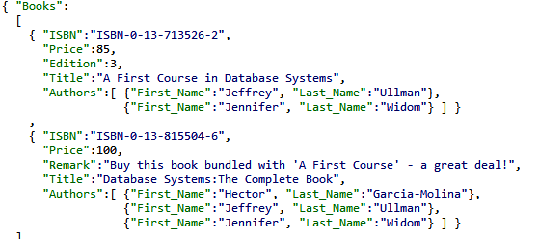
JavaScript Object Notation (JSON)
Another data model, like XML and relational data
Standard for “serializing” data objects usually in files
Human-readable, useful for data interchange
Also useful for representing & storing semi-structured data

Slide 3
JavaScript Object Notation (JSON)
No longer tied to JavaScript
Parsers for many languages

Slide 4
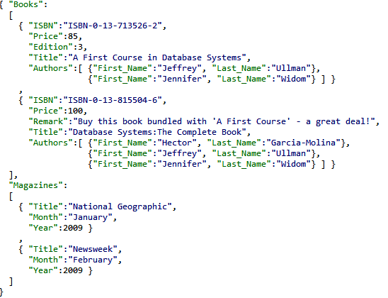
JSON
Basic constructs (recursive)
Base values
Number, string, boolean
Objects {}
Set of label-value pairs
Arrays []
List of values

Slide 5
Relational Model vs. JSON
 | Relational | JSON
Structure | Tables | Nested sets and arrays
Schema | Fixed in advance | Self-describing, flexible
Queries | Simple, expressive languages | Nothing that is as widely used
Ordering | None | Arrays
Implementation | Native systems | Coupled with programming languages; NoSQL systems

Slide 6
Syntactically Valid JSON
Adheres to basic structural requirements
Sets of label-value pairs
Arrays of values
Base values from predefined types
JSON
File
JSON
Parser
Program
objects
Syntactic errors

Slide 7
Semantically Valid JSON
Adheres to basic structural requirements + conforms to specified schema
JSON
File
JSON
Validator
JSON
Parser
Program
objects
JSON
Schema
Syntactic errors
Semantic errors

Slide 8
Demo
Constructs and syntactic correctness
Flexibility
JSON schema, validation

Slide 9
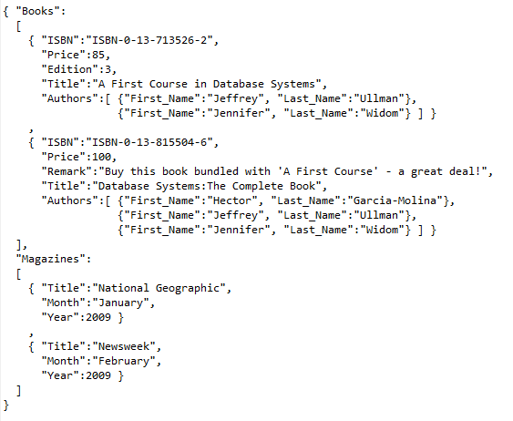
Demo Data (Bookstore.json)

Slide 10
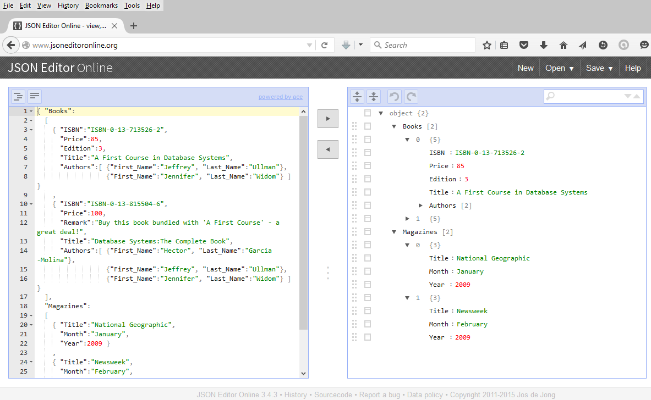

Slide 11
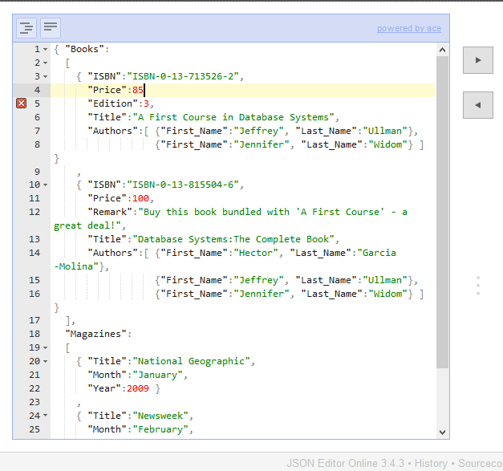
Error?
Error?

Slide 12
Comma missing

Slide 13
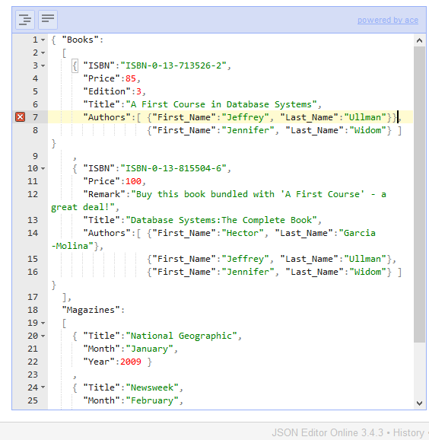
Error?
Error?

Slide 14
Extra brace

Slide 15
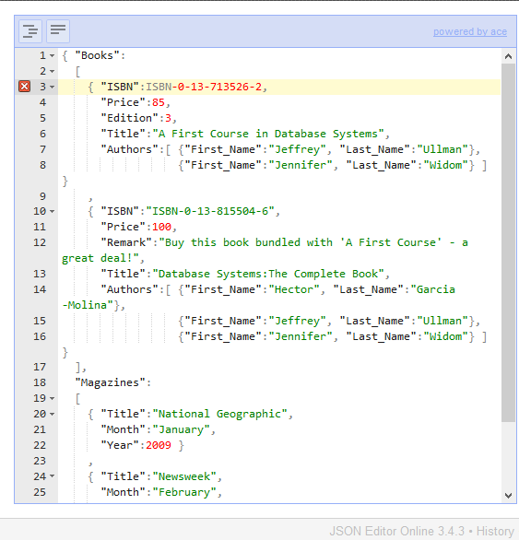
Error?
Error?

Slide 16
Quotes around string missing

Slide 17
Only unquoted values
Numbers
null
true
false

Slide 18

Error?
Error?

Slide 19
Quotes around label missing

Slide 20
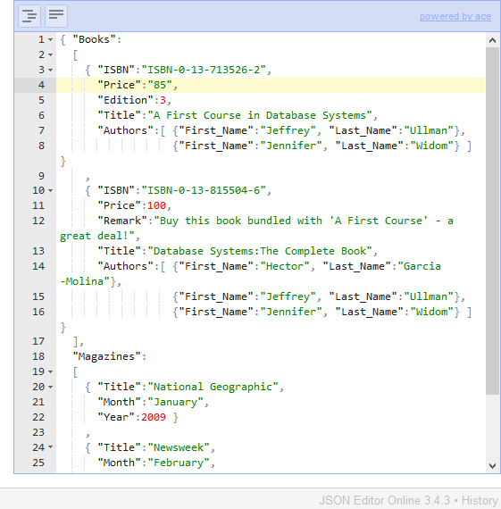
Price value quoted – not an error

Slide 21
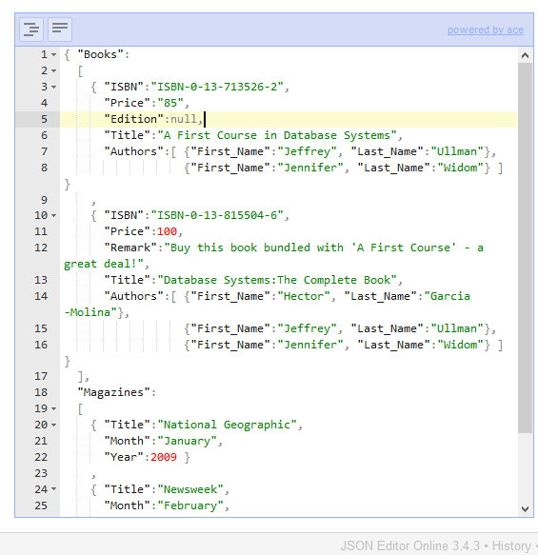
Null (reserved word) value is acceptable, no quotes

Slide 22

Error?

Slide 23
Not a reserved word, no quotes

Slide 24
Arrays don’t need to have the same type of values as their elements

Slide 25
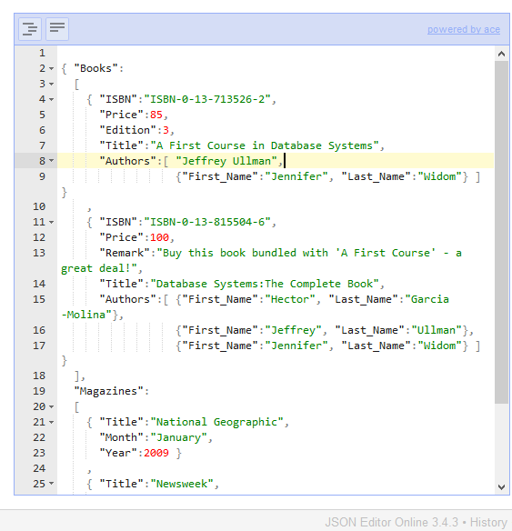
First element of Authors changed to simple string

Slide 26
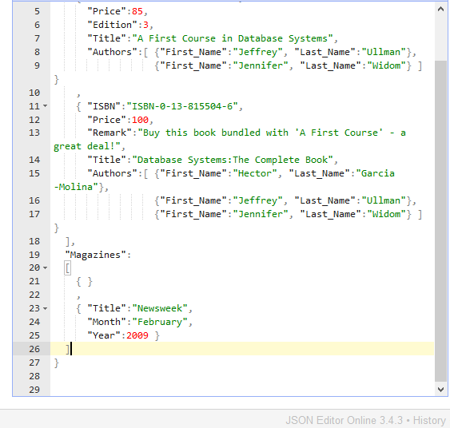
Empty elements also acceptable (see Magazines)

Slide 27
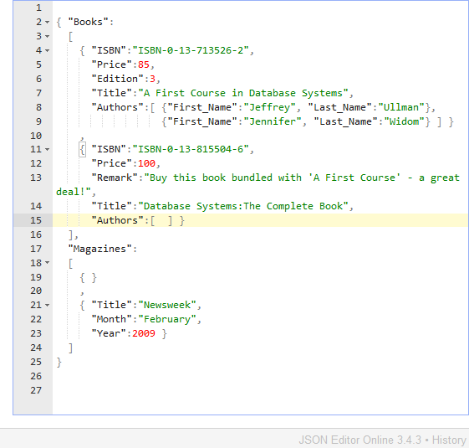
Array length can be zero (see Authors)

Slide 28
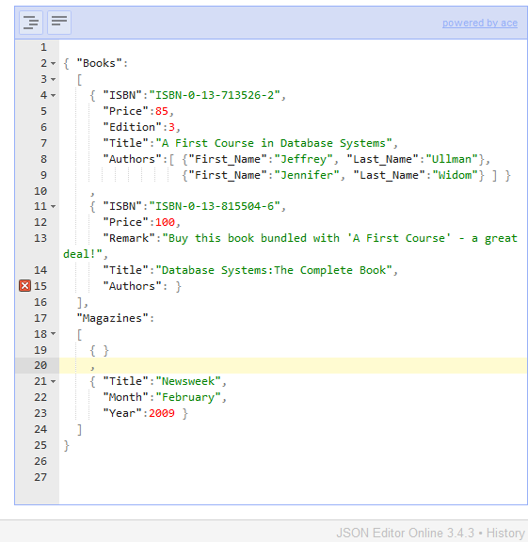
Error?
Error?

Slide 29
Entire value is now missing from the label-value pair

Slide 30

One string element in the array is acceptable

Slide 31

Error?
Error?

Slide 32
The value is an object, and objects are always label-value pairs

Slide 33
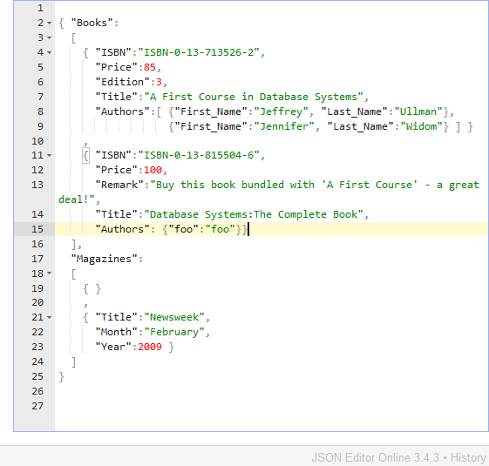
This is acceptable

Slide 34
Examples Recap
Syntactic correctness examples
No required uniformity across values and arrays, or in objects

Slide 35
Json schema: add constraints beyond basic syntactic correctness

Slide 36
Like xml schema, expressed in the data model itself

Slide 37
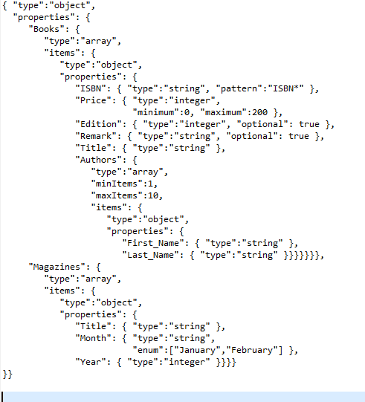
JSON SCHEMA

Slide 38
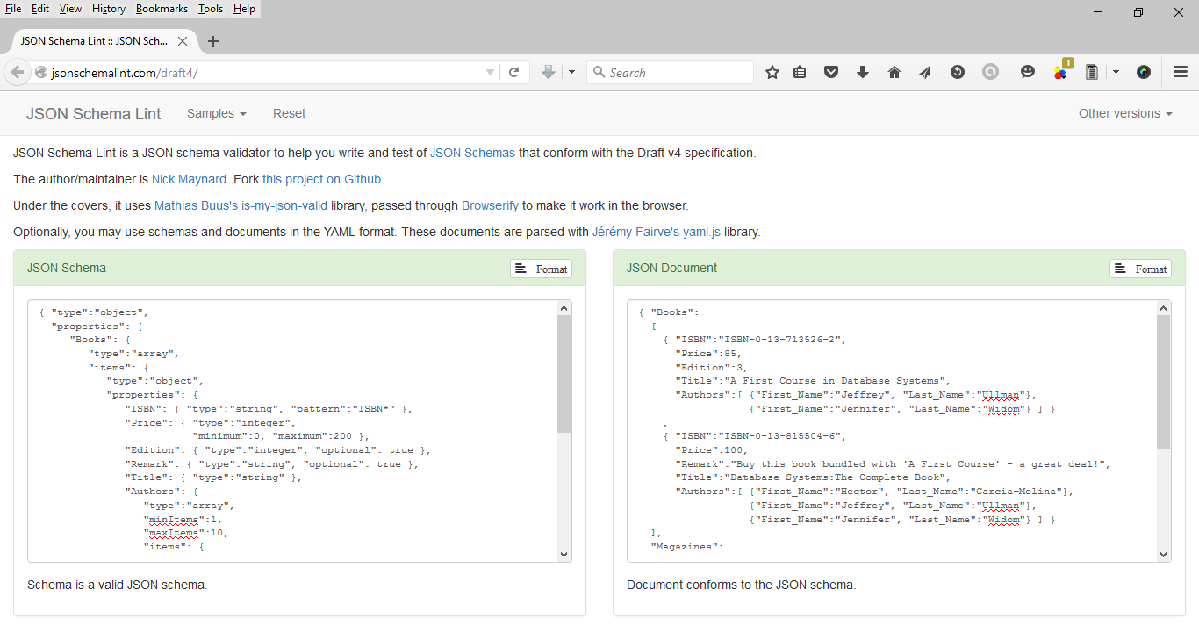
Validator

Slide 39
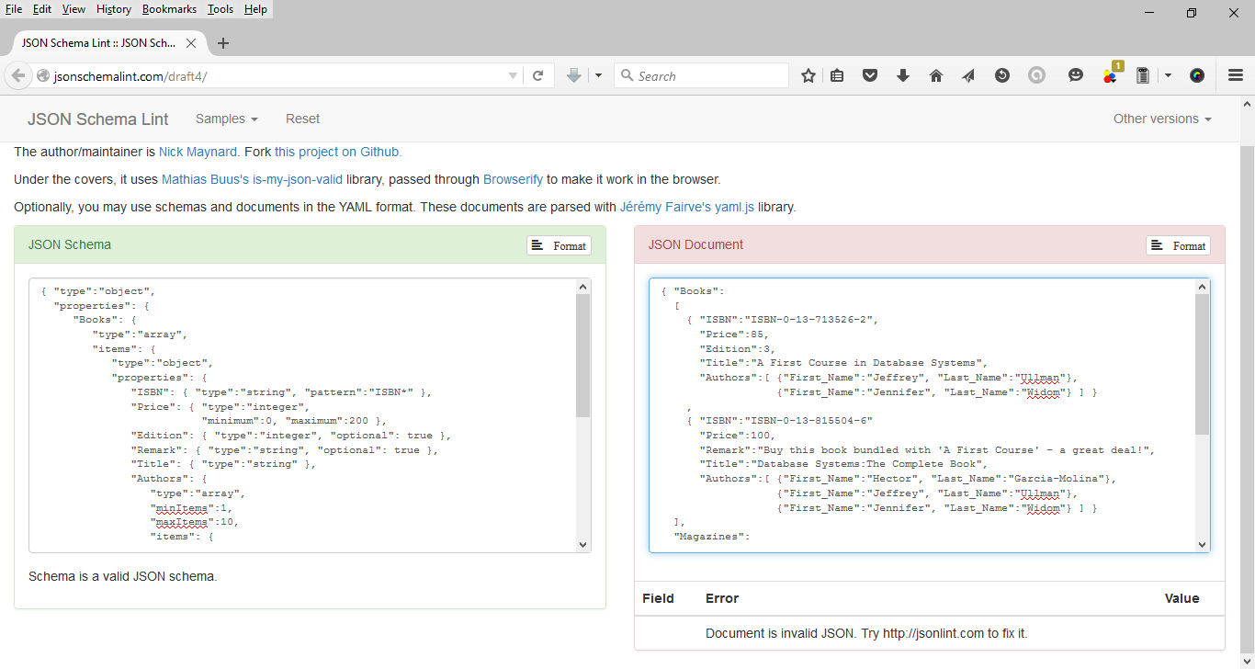
Catches syntactic errors (comma removed)

Slide 40
semantic correctness demo

Slide 41
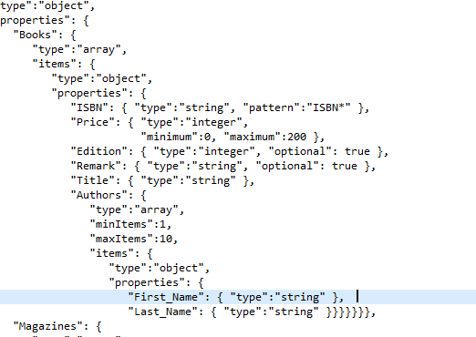
Price Specification

Slide 42
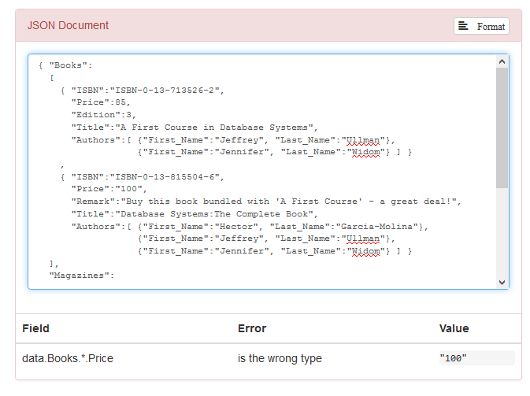

Price as a string will not validate

Slide 43
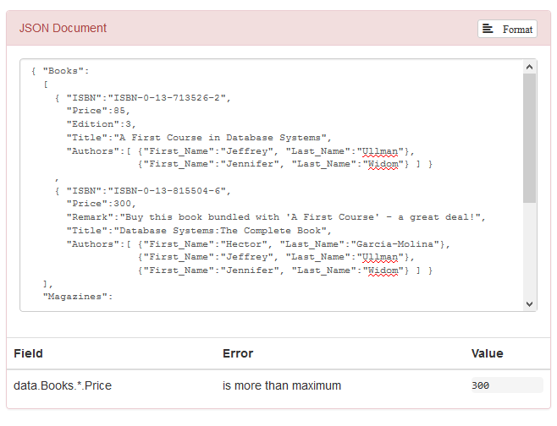
Price above range will not validate

Slide 44
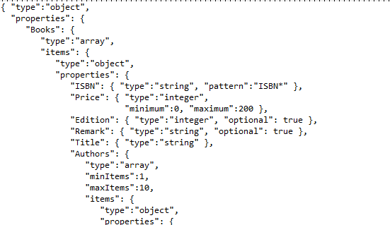
Pattern matching for strings

Slide 45
Isbn*
String should start with ISBN and can be followed by anything else.

Slide 46
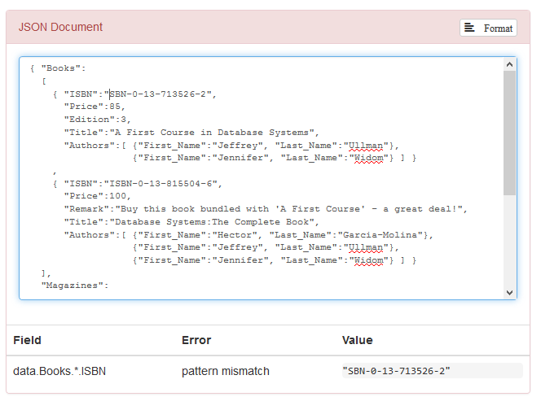
Drop I from ISBN, validation fails

Slide 47
Constrain number of elements in an array

Slide 48
Array Constraints

Slide 49
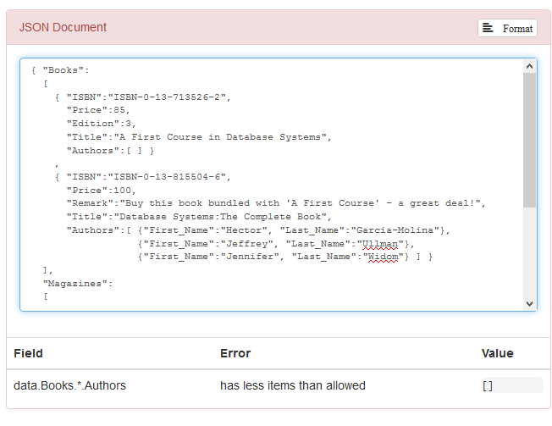
Error on removing all authors

Slide 50
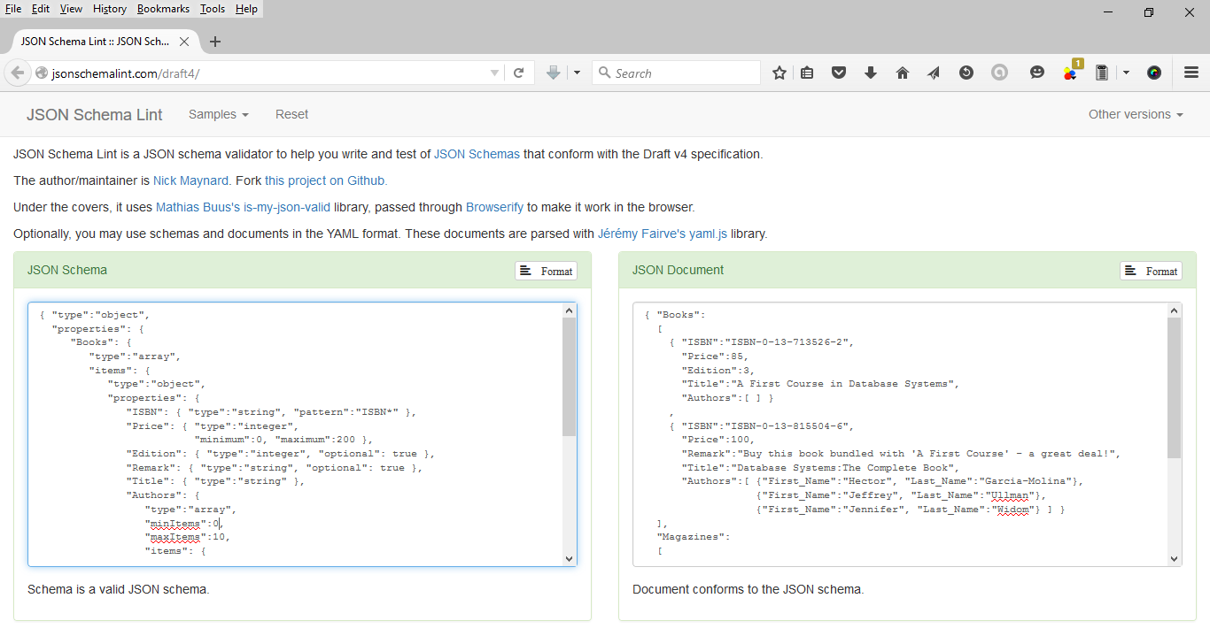
Validates when minItem set to zero

Slide 51
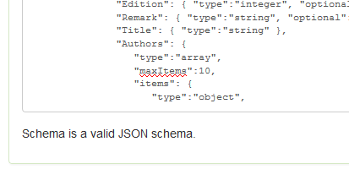
Or just remove the minItem constraint – still valid

Slide 52
Adding items that aren’t in the schema

Slide 53
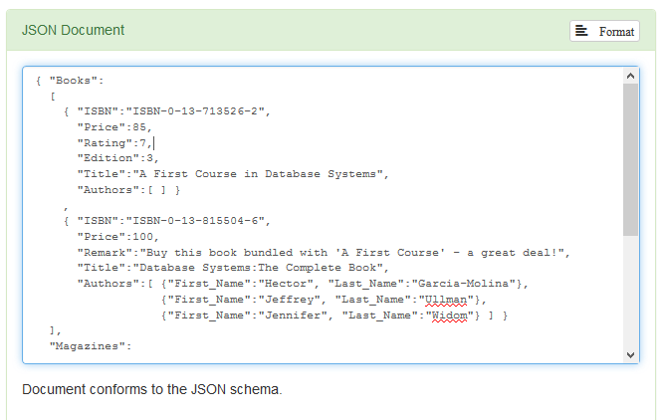
Add “rating” – validates – even though it is not in the schema

Slide 54
Additions are allowed by default – but can be disallowed by setting a flag in the schema
“additionalProperties”:false

Slide 55
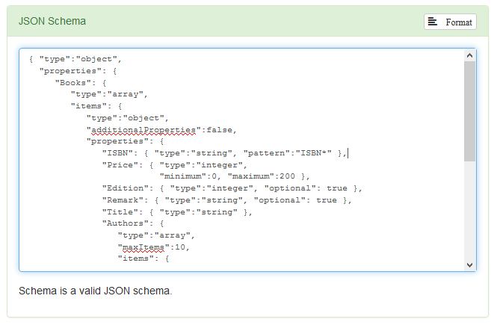
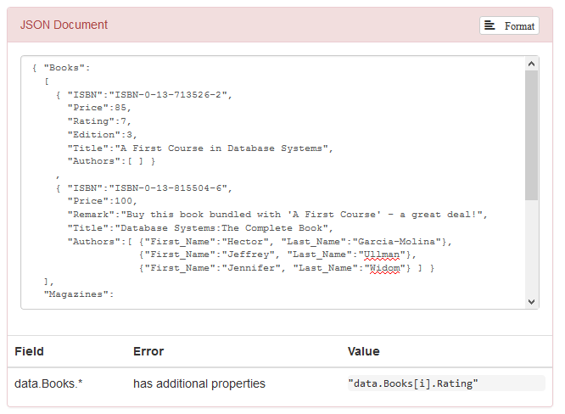

Slide 56
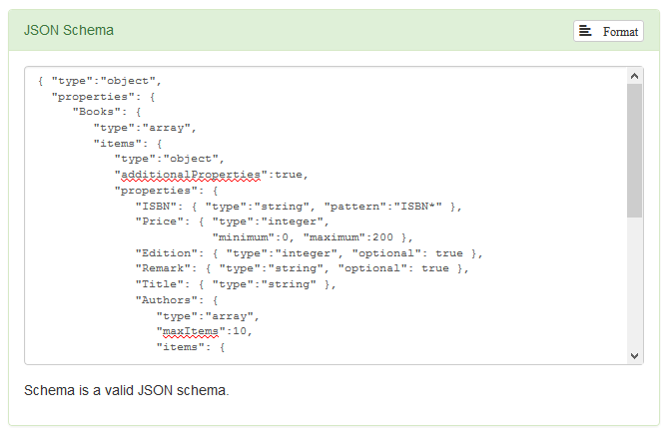
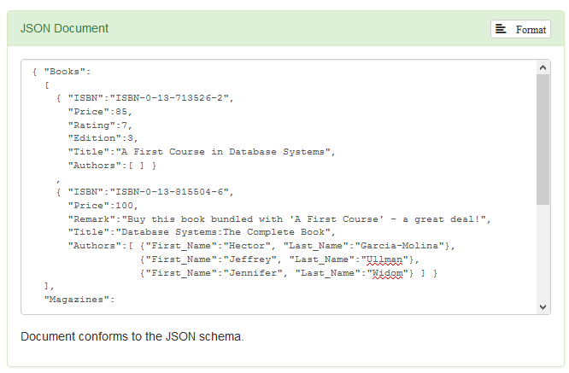
Changed to true -
validates both for default or true

Slide 57

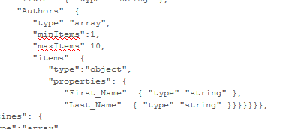
Missing First_Name – will not validate

Slide 58
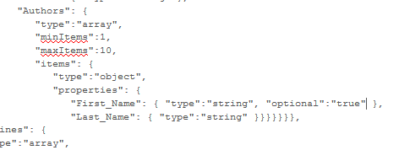
Unless optional label is set to true

Slide 59
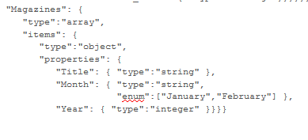
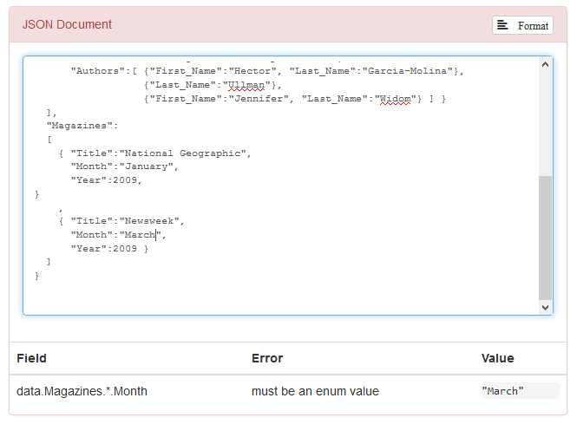
Enum – March value does not validate

Slide 60
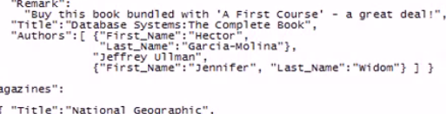
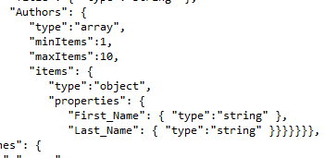
Turn object to string – does not validate now – schema specifies array of objects in Author

Slide 61
Different types can be allowed by specification – e.g., allow year as int & string

Slide 62
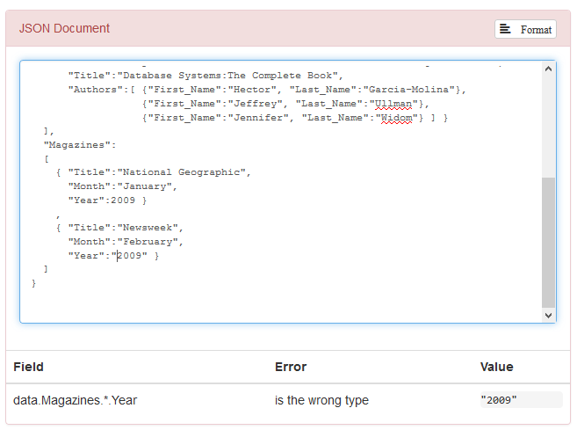
Original file will not validate with the year as a string

Slide 63

Change specification to array

Slide 64
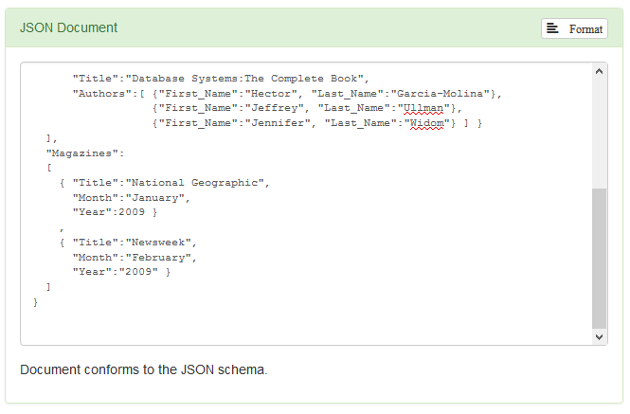
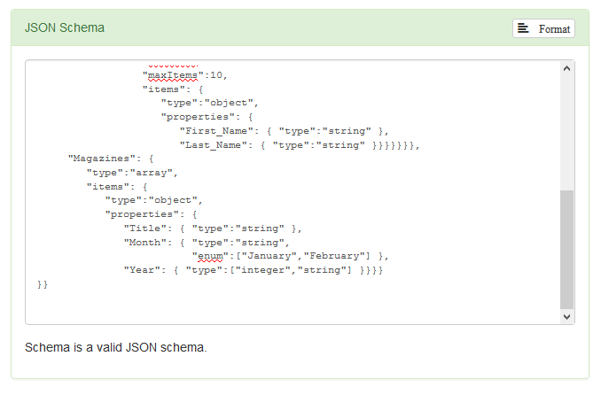
Validating for both string and int year now

Slide 65
End of demo. Not exhaustive. Just an example.

Slide 66
Content adapted from http://www.webmonkey.com/2010/02/get_started_with_json and http://www.w3schools.com/json/default.asp

